Slide 1
Case Study 3

Slide 2
Read the Question in the Image

Slide 3
Q1) You need to debug the website remotely. Which three actions should you take? Each correct answer presents part of the solution.
In the Azure management portal, configure a monitoring endpoint.
In the Azure management portal, set remote debugging to On and set the Visual Studio version to 2013.
Install the Azure SDK for .NET on the computer that runs Visual Studio.
In the web.config file for the website, set the debug attribute of the compilation element to true.
In the Azure management portal, set the web hosting plan to Standard.

Slide 4
Q1) You need to debug the website remotely. Which three actions should you take? Each correct answer presents part of the solution.
In the Azure management portal, configure a monitoring endpoint.
In the Azure management portal, set remote debugging to On and set the Visual Studio version to 2013.
Install the Azure SDK for .NET on the computer that runs Visual Studio.
In the web.config file for the website, set the debug attribute of the compilation element to true.
In the Azure management portal, set the web hosting plan to Standard.

Slide 5
Explanation
“You must develop the website by using Microsoft Visual Studio 2013.”
Because the Website is developed in the visual studio 2013, we can debug the website by setting debugging on in the setting of the webpage.
We would need a VS2013 with Azure SDK for the debugging and we need to specify in the Web.config file to enable debug as true
Links: https://msdn.microsoft.com/en-us/library/e8z01xdh.aspx

Slide 6
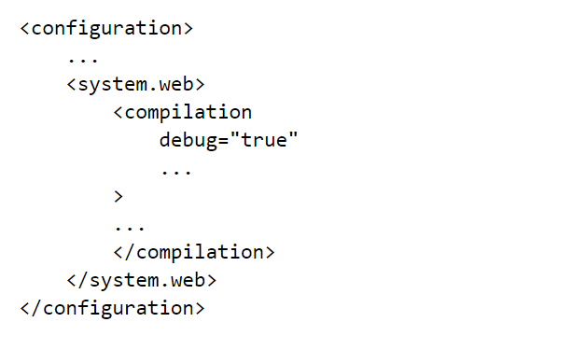

Slide 7
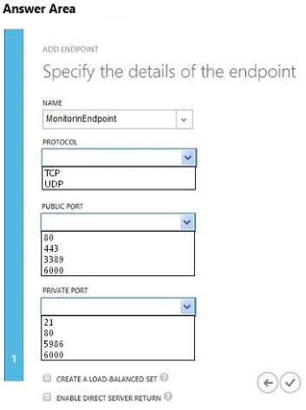
Q2) You need to implement endpoint monitoring.

Slide 8
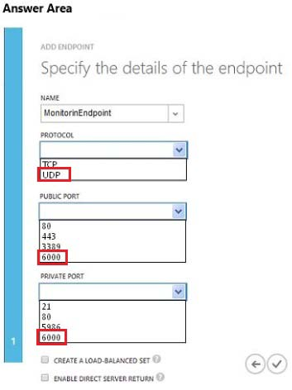
Q2) You need to implement endpoint monitoring.

Slide 9
Explanation
“The website must use port 6000 with UDP to submit information to another process. This port must be actively monitored by using the same external port number.”
As the Question specifies we need to Implement End Point monitoring with UDP protocol and the Internal port number is 6000 and external port number is also 6000.

Slide 10
Q3) You need to move the VM. What should you do?
Use the Blob Service REST API
Use the Service Management REST API
Run the Azure PowerShell Convert-VHD cmdlet.
Run the Azure PowerShell New-AzureVMcmdlet

Slide 11
Q3) You need to move the VM. What should you do?
Use the Blob Service REST API
Use the Service Management REST API
Run the Azure PowerShell Convert-VHD cmdlet.
Run the Azure PowerShell New-AzureVMcmdlet

Slide 12
Explanation
Link : https://azure.microsoft.com/en-gb/blog/migrate-azure-virtual-machines-between-storage-accounts/
Open Link and seethe Concept.

Slide 13
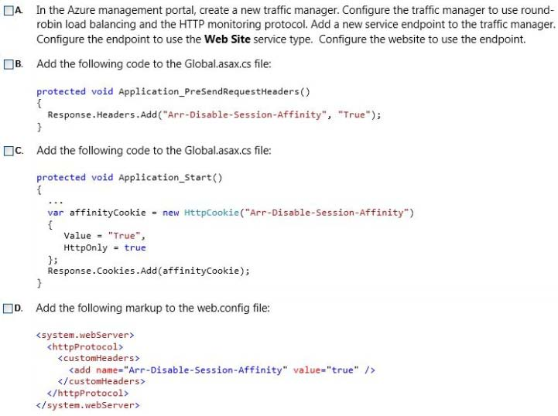
4) You need to configure session affinity for the website.

Slide 14
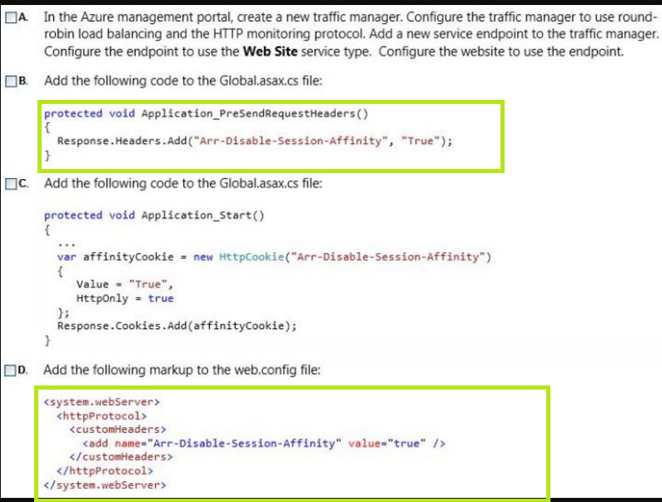

Slide 15
Explanation.
“The website must be stateless. Subsequent requests from a user might or might not be routed back to the website instance that the user initially connected to.”
Session Affinity means that when a request comes into a site from a client all further requests go to the same server initial client request accessed. It is also referred to as Sticky Sessions.
Because the specification mentions that we need a stateless protocol and the subsequent requests might not be routed to the website instance that the user previously connected to.
We need to disable the ARR Instance Affinity
What is ARR ? Application Request Routing. This is a equivalent to Application level Load Balancer.
ARR is an IIS extension to distribute your connecting users between your active instances. ARR cleverly keeps track of connecting users by giving them a special cookie (known as an affinity cookie), which allows it to know, upon subsequent requests, to which server instance they were talking to.
Open Link :
https://azure.microsoft.com/en-in/blog/disabling-arrs-instance-affinity-in-windows-azure-web-sites/

Slide 16
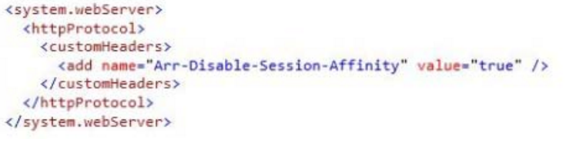
Explanation
Disabling the ARR can be done in 3 Ways
Go to the website Application settings in the azure portal and change the settings for ARR to OFF.
Change the Configuration file web.config

Slide 17
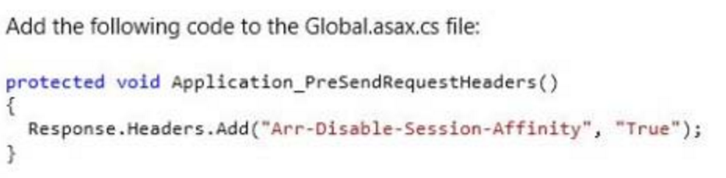
Explanation
3) It specifies to add this headers to all the request headers.

Slide 18
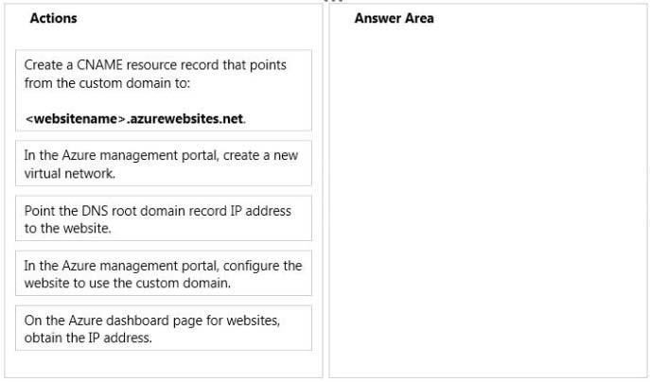
Q4) You need to complete the domain configuration for the website.

Slide 19
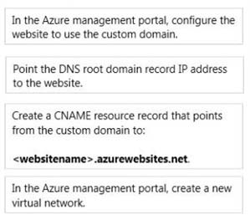

Slide 20
Explanation
See the Video of Configuring custom Domain in webApps

Slide 21
You need to implement the web application deployment workflow.In the Azure management portal, what should you do?
Set the web hosting plan to Shared. Increase the instance count to 2. Publish the incremental updates to the new instance.
Set the web hosting plan to Standard. Use Windows PowerShell to create a new deployment slot to publish the incremental updates. Swap the deployment slot after the business users have validated the updates.
Set the web hosting plan to Standard. Create a new website to host the updated web application. Create a Windows PowerShell script to move the contents of the new website to the production website location after the business users have validated the updates.
Download the publish profile. Use Visual Studio to import the publish profile. Deploy the web application by using the Visual Studio Publish Web wizard after the business users have validated the updates.

Slide 22
You need to implement the web application deployment workflow.In the Azure management portal, what should you do?
Set the web hosting plan to Shared. Increase the instance count to 2. Publish the incremental updates to the new instance.
Set the web hosting plan to Standard. Use Windows PowerShell to create a new deployment slot to publish the incremental updates. Swap the deployment slot after the business users have validated the updates.
Set the web hosting plan to Standard. Create a new website to host the updated web application. Create a Windows PowerShell script to move the contents of the new website to the production website location after the business users have validated the updates.
Download the publish profile. Use Visual Studio to import the publish profile. Deploy the web application by using the Visual Studio Publish Web wizard after the business users have validated the updates.

Slide 23
Explanation
“ You must establish a continuous deployment process that uses staged publishing.”
“You initially configure the website to use the Basic hosting plan”
This states that we need to employ the staging concept. Hence option 2, Because the concept of the deployment slots is not available in the Basic plan we need to move to the standard plan.

Slide 24
You need to choose an Azure storage service solution. Which solution should you choose?
Queue storage
Blob storage
File storage
Table storage

Slide 25
You need to choose an Azure storage service solution. Which solution should you choose?
Queue storage
Blob storage
File storage
Table storage

Slide 26
Explanation
“The custom executable must use native file system APIs to share data between different parts of the website.
The custom executable must continue to use a network file share to access files.”
So we go for the File Storage.

Slide 27
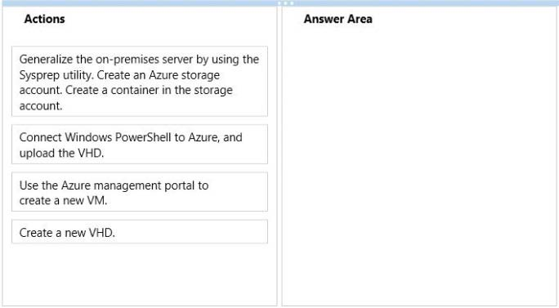
Q6)You need to create the VM to replace the on-premises server.

Slide 28
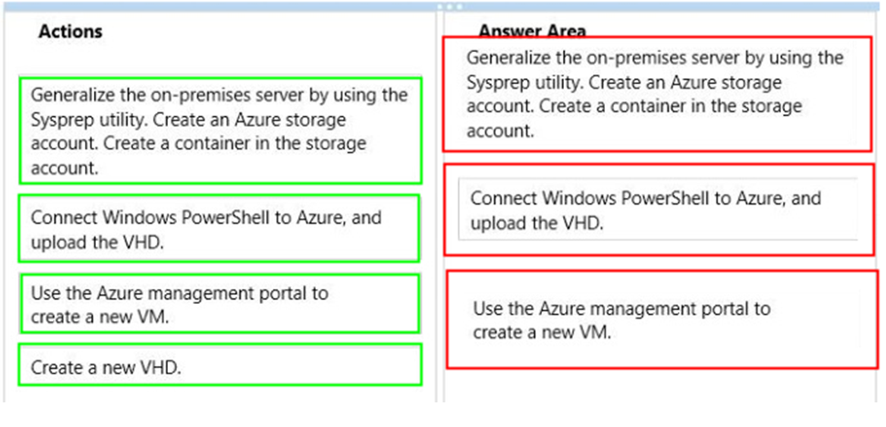

Slide 29
Explanation.
The System Preparation tool (Sysprep) is a technology that you can use with other deployment tools to install Microsoft Windows operating systems with minimal intervention by an administrator or technician. Sysprep is typically used during large-scale rollouts when it would be too slow and costly to have administrators or technicians interactively install the operating system on individual computers.
Use Sysprep tool on the on - premises server to get the VHD file on that computer. Create a storage account and add a container to it. Connect to the Azure Account using powershell and upload the VHD. In the azure portal go to create a new VM and specifying the above created storage account as your storage account.

Slide 30
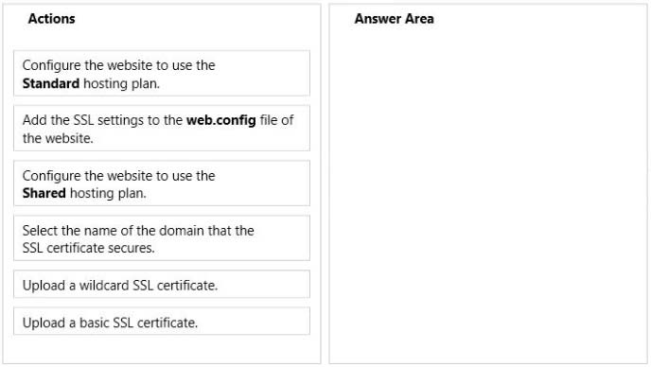
You need to secure the website.

Slide 31
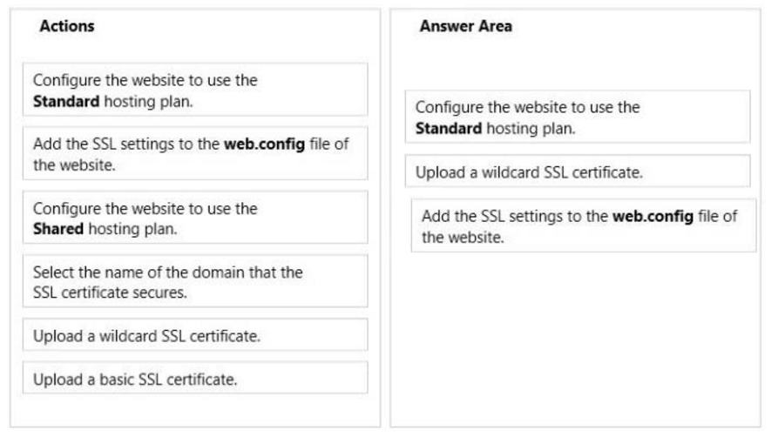
You need to secure the website.

Slide 32
Explanation.
SSL is allowed only in the standard hosting plan.
Because CAs provide the various SSL certificate types at different price points, you should start by deciding what type of SSL certificate to buy. To secure a single domain name (www.contoso.com), you just need a basic certificate. To secure multiple domain names (contoso.com and www.contoso.com and mail.contoso.com), you need either a wildcard certificate or a certificate with Subject Alternate Name (subjectAltName).

Slide 33
Adding the SSL config to web.config
Open the siteroot/web.config file.
Find these settings.
<add key="ek_UseSSL" value="false" /> <add key="ek_SSL_Port" value="443" />
Set ek_UseSSL to true.
Set the ek_SSL_Port to 443 (unless you specified another SSL port).
Find the following line: <add key="WSPath" value="http://server name/site name/Workarea/ServerControlWS.asmx" />
Change http to https.
Save and close the file.

Slide 34
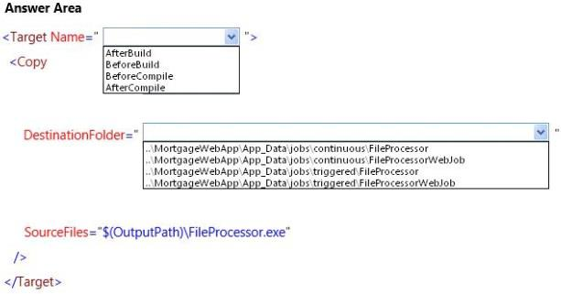
You need to deploy the FileProcessor.exe program.

Slide 35
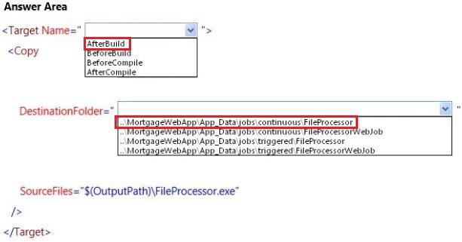

Slide 36
Explanation
“The custom executable must run continuously and must be deployed as an Azure web job named FileProcessor”
Cointinuous job so inside continuous folder.Deployment should be done after build.
When Visual Studio deploys a WebJobs-enabled Console Application project, it performs two tasks:
· Copies runtime files to the appropriate folder in the web app (App_Data/jobs/continuous for continuous WebJobs, App_Data/jobs/triggered for scheduled and on-demand WebJobs).
· Sets up Azure Scheduler jobs for WebJobs that are scheduled to run at particular times. (This is not needed for continuous WebJobs.)
+
A WebJobs-enabled project has the following items added to it:
· The Microsoft.Web.WebJobs.Publish NuGet package.
· A webjob-publish-settings.json file that contains deployment and scheduler settings.

Slide 37
